Slide 1

Title: What is human thinking?
Present By:
Dr Mohamed hafez

Slide 2


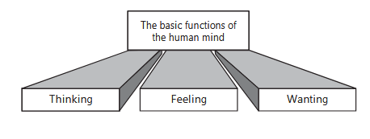
Scientific Thinking
What is human thinking?
The Human Mind: Its Nature and Functions

Slide 3
Scientific Thinking
The basic functions of the human mind
Thinking is the part of the mind that figures things out. It makes sense of life’s events.
Feelings are created by thinking evaluating whether the events of our lives are positive or negative.
Wanting allocates energy to action, in keeping with what we define as desirable and possible.

Slide 4
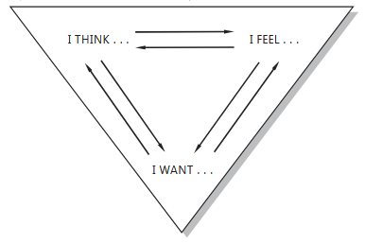
Scientific Thinking
There is an intimate, dynamic interrelation between thinking, feeling, and wanting.

Slide 5
Scientific Thinking
What is thinking?
The variety of activities called 'thinking' is extremely large but includes at least:
reflecting, anticipating, deciding, imagining, remembering, wondering, pondering, intending, believing, disbelieving, meditating, inferring understanding, predicting and introspecting.

Slide 6
Scientific Thinking
All thinking has some subject matter.
"I did it without thinking”
Many of our actions are instinctive or automatic responses to certain situations … Many again are matters of habit.

Slide 7
Scientific Thinking
when we begin to think?
we begin to think when we are confronted with a difficulty, perplexity, or problem, that is, an unfamiliar situation to which we have no response ready, either instinctive or habitual.
Thinking therefore should first of all be distinguished from day-dreaming.
Thinking is essentially purposive — directed and controlled

Slide 8
Scientific Thinking
Definition of Thinking
Thinking is the highest mental activity present in man. All human achievements and progress are simply the products of thought.
Thinking is to use the mind for processing imagination and information, to arrive at logical conclusions, from premises known.
Thinking is the process of using your mind to consider something carefully.
Thought and action are inseparable - they are actually the two sides of the same coin.

Slide 9


